Slide 1


Microsoft AL Modern APIs

Slide 2
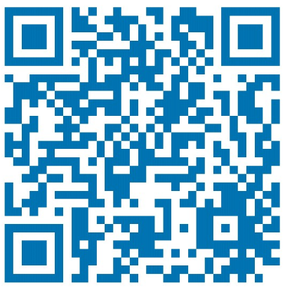




Competence Team DevTech
Profil
Never stop learning!
Technology Evangelist
Microsoft AL – Business Central – Azure – Cognitive Services – PowerShell – Docker – Git – DevOps – .NET – C# – JavaScript – SQL – LINQ – …
@MMe2K
Teams-Channel
Microsoft AL
Michael Megel Business Development @ cc Dresden

Slide 3
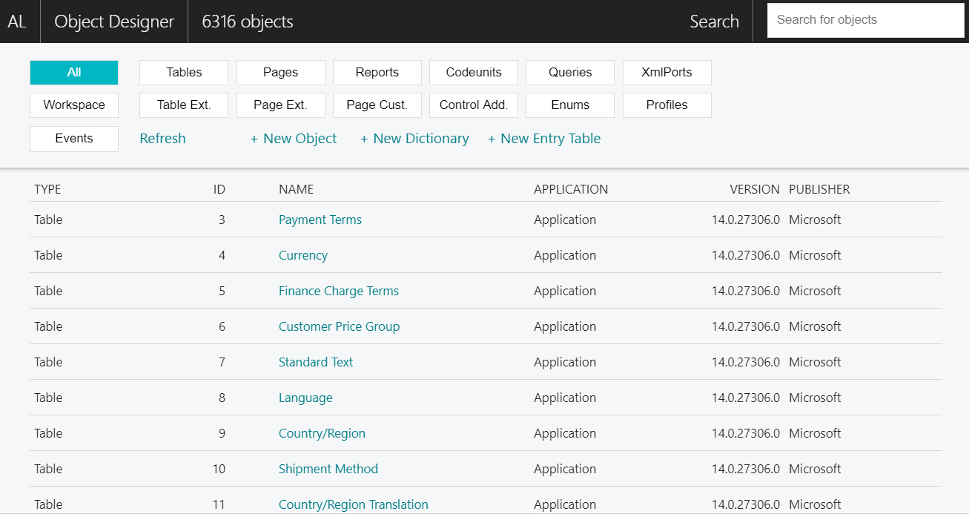

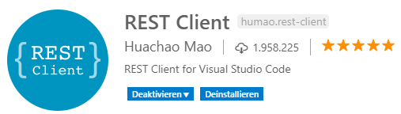
VS Code Useful Extensions
AL Formatter
AL Code Outline
AL Object Designer
CRS AL Language Extension
JSON5 syntax
AL Runner
REST Client
VS Live Share
Visual Studio Live Share Extension Pack
Visual Studio IntelliCode

Slide 4

Business Central
Overview
Explore & Setup
Microsoft AL
Web Services
OData Feeds
Modern APIs
Tools & Simulation
Hand On

Slide 5
Business Central Extending and integrating
Extensions 2.0
API’s
Add-On
Connect
Add-on apps enrich the Business Central functionality
Connected Apps connect another service with Business Central
Notes:
As powerful as PowerBI, PowerApp and Flow etc. are, there are times where you want to go one step further.
We’ve categorized this into three types of App’s you can build. We are understanding each of the three from a customer need perspective.
Connect:
- Connect App – the need for a customer to connect two different systems is a common scenarios. Payroll is a common scenario. Another common scenario is eCommerce. Bi-directionaly Inventory. Or it could be a mobil App for managing expenses.
- We have made a major investment in API’s for you to use, I will show you some details in the coming slides.
Add-On:
- From a customer perspective, Add-on is a powerful feature that enables you as ISV’s and developers to extend Financial & Operations with addition capabilities build right into the experience the customer is used to and feel comfortable in. Commen scenarios are shipping,
- Add-on’s are rather unique to Financials. Most competing systems stop at API’s, but we are taking this one important stop further!
Embed:
-
we need to connect one business application with another as well as times where we want to extend the experience and the capabilities right inside the Financials Application.
We can do this too!!
In fact we believe that we are quite unique here. Let me explain why…

Slide 6
Business Central Add-on vs. Connect apps
Connect apps supplement add-ons!
You can even combine the two, relying on an add-in for setup UI or two way communication
 | Strengths | “Weaknesses” | Suitable for
Add-on apps | Powerful customization abilities In-client designer | Require knowledge of internal business logic and data model | Deep integration Embedded user experience ISV solutions
Connect apps | Simplicity of REST api’s Similarity with other SaaS services Fairly quick development cycle Large choice of coding platforms | Cannot modify UI or business logic | Data integration Integration with online services, SaaS ISV solutions Developers with no Dynamics 365 Business Central experience

Slide 7
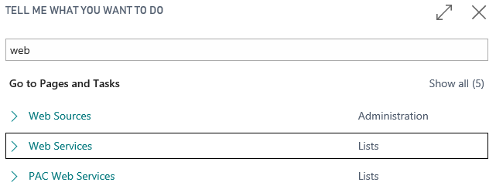
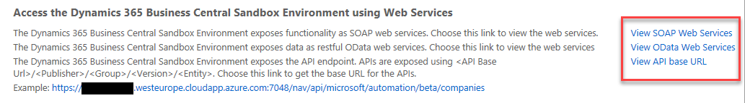
Business Central API and Web Services
SOAP web services
Codeunit
Page
Query
OData web services
Page
Query
API endpoints
Page PageType = API

Slide 8
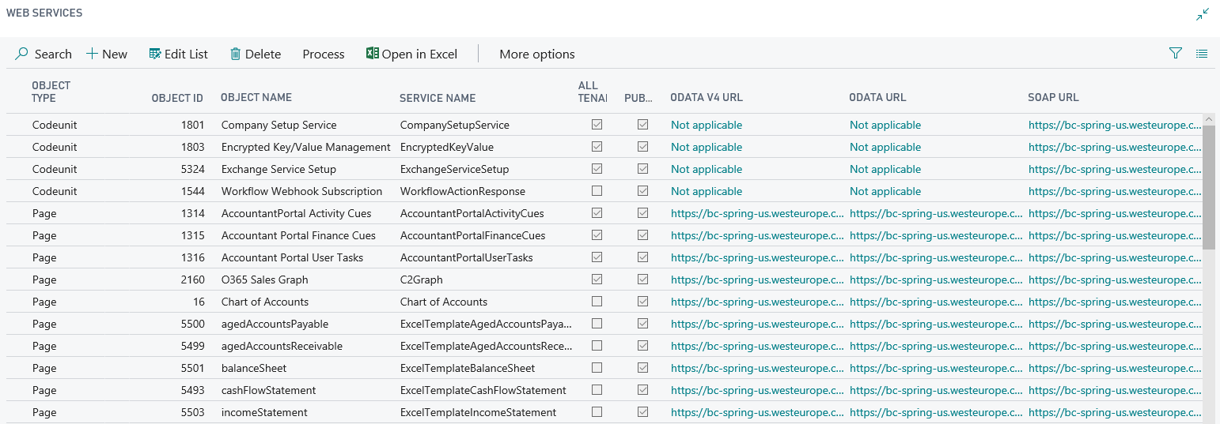
Business Central Explore classic Web Services
[ALT] + [Q] … Tell Me … Web Services
Codeunits, Pages & Queries

Slide 9
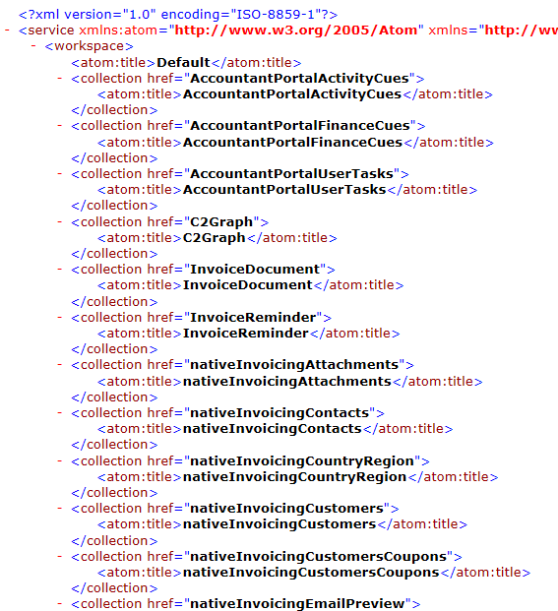
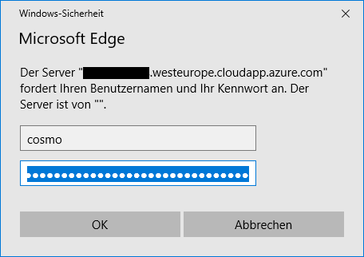
Business Central Explore classic Web Services
Copy the URL from
Web Services Page
Landing Page
Basic Authentication
Username
Web Access Key

Slide 10
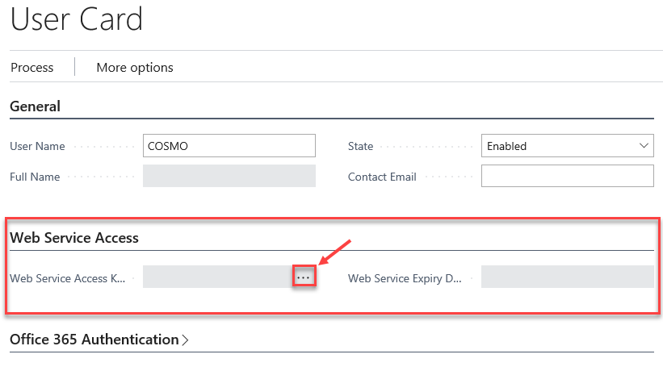
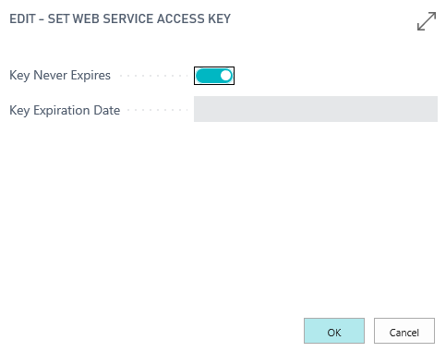
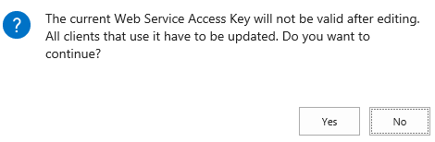
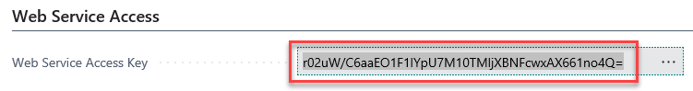
Business Central Setup Web Service Access
Open „Users“ and select the right user
Open „User Card“
Create a „Web Service Access” Key
Adjust the Key Expire
Confirm
Copy the Key
Authentication
Basic
User & Password

Slide 11
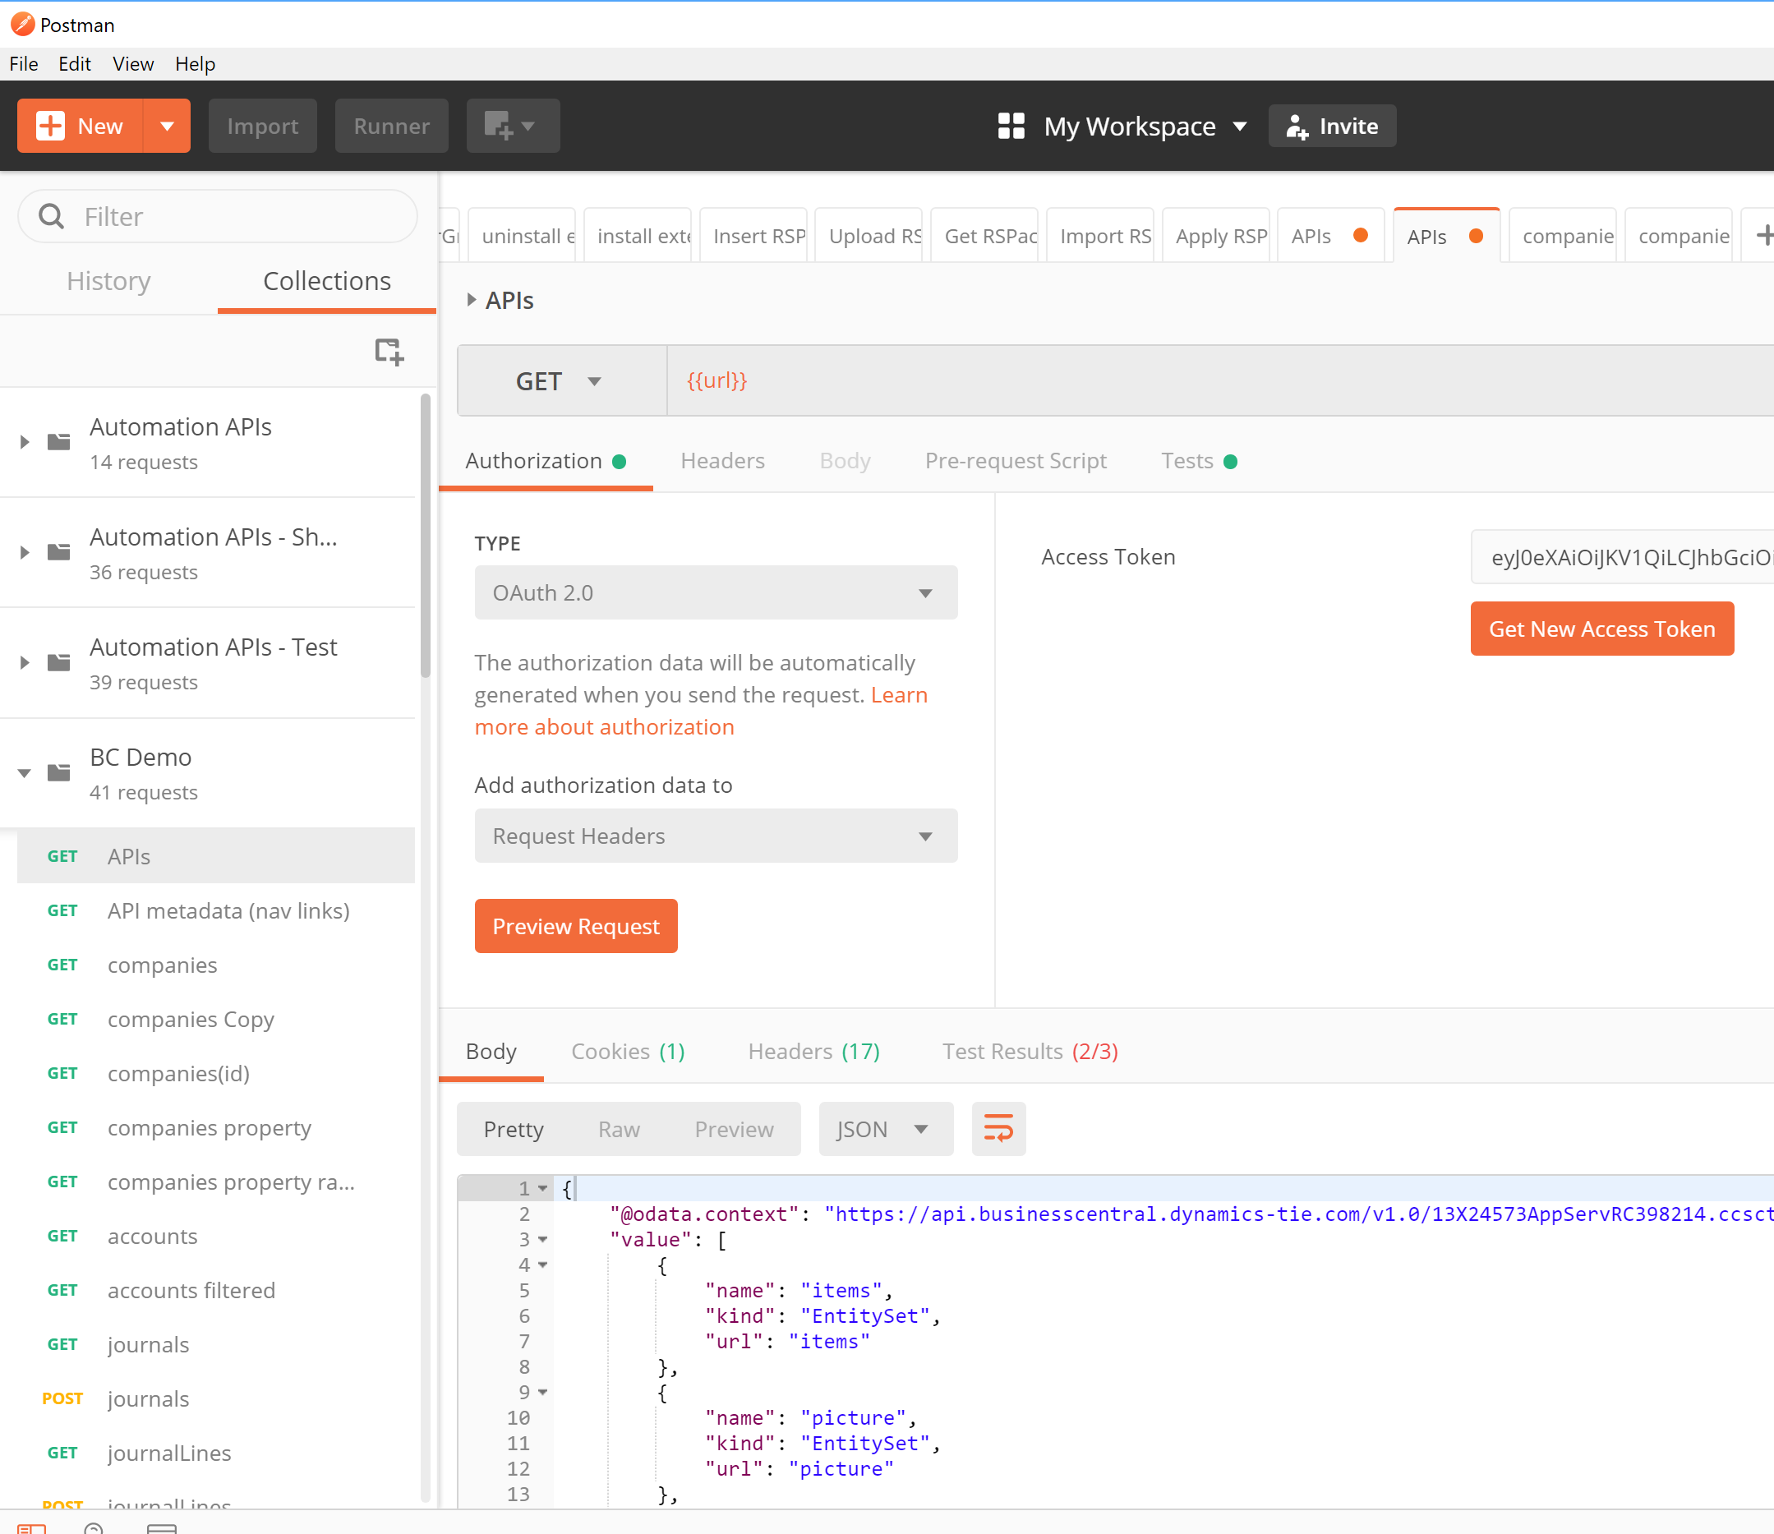
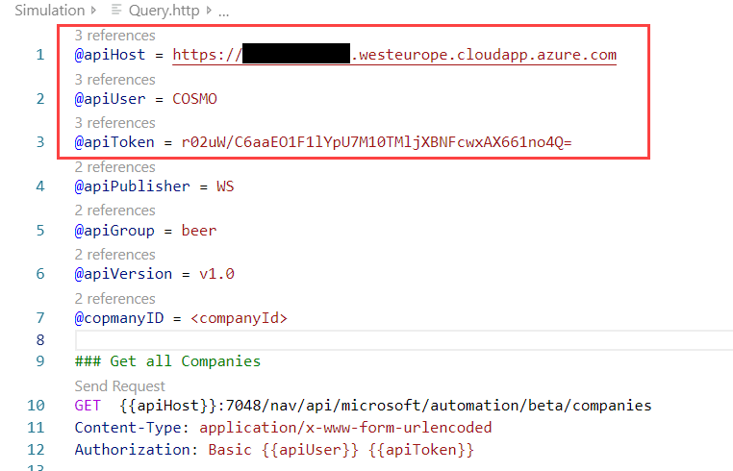
Business Central Tools for Web Service Development & Test
Fiddler
Postman
VS Code REST Client

Slide 12

Hands On

Slide 13
Business Central Hands-On
Prerequisites
Connect to your Workshop VM → use Instructions on your Workshop Boarding Pass
Hand On - Tasks
Learn how to explore Web Services
Setup the Web Account in your environment

Slide 14
Business Central Explore the Web Services
Open your Web Client
Use “Tell me” and navigate to the web services
Page Name “Web Services”
Note the Web Service URL (for later) of:
Page “User Tasks”
Query “Vendor Ledger Entries”

Slide 15
Business Central Setup your Web Service Access
Open your Web Client
Use “Tell me” and navigate to the web services
Page Name “Users”
Open User Page
Setup the Web Service Access
no expire date
Note your generated Web Service Access Key and Username

Slide 16

Microsoft AL Web Services & OData Feeds

Slide 17
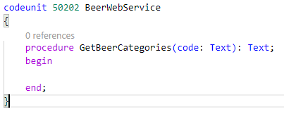
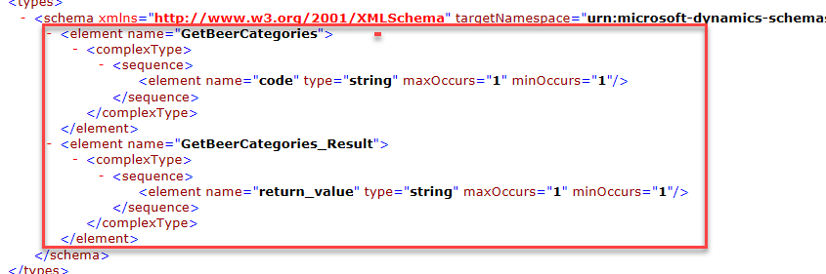
Business Central | Web Services Codeunit
Codeunit
SOAP only
Wrapper for Methods
Procedure
Web Service Method for SOAP
Method Arguments
Request Parameters in SOAP
Method Result
Response Data in SOAP

Slide 18
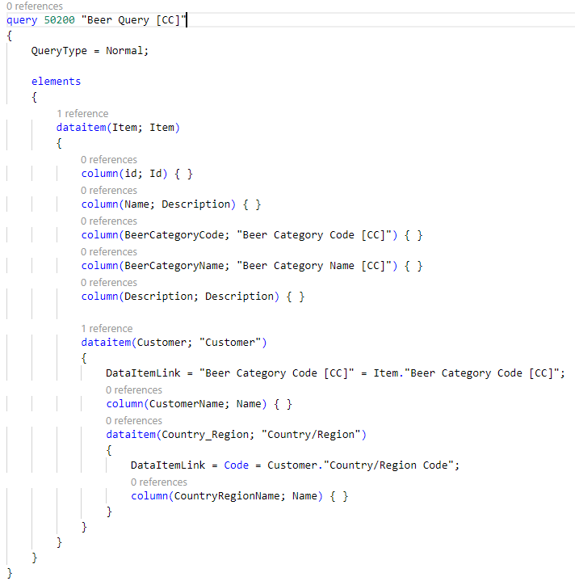
Business Central | Web Services Query
Query
SOAP, OData, OData v4
QueryType = Normal
Data Items
Table
Columns
Nested Data Items
DataItemLink specify the JOIN Sets a reference between one or more fields of the data item table and data item or data items above it.
DataItemTableFilter Sets filters on fields of the underlying table of a query.
SQLJoinType may replace the DataItemLinkType Sets the data item link type between data items in a query to determine the records that are included in the resulting dataset.

Slide 19
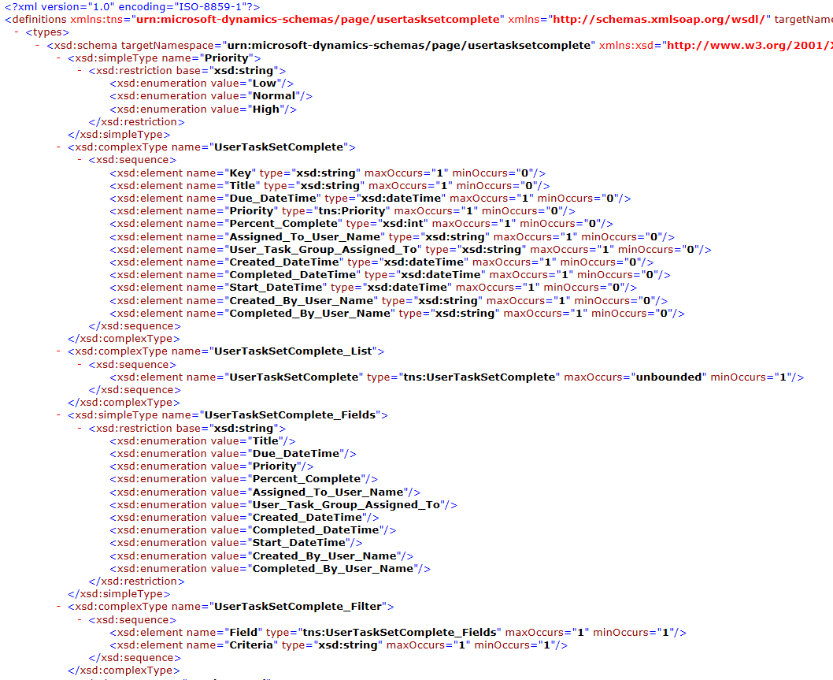
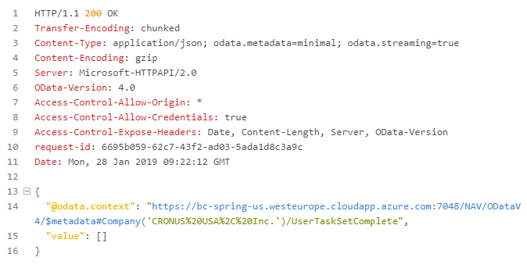
Business Central | Web Services Page
Page
SOAP
OData
OData v4
Access to Page Records
Actions as Web Service Methods

Slide 20
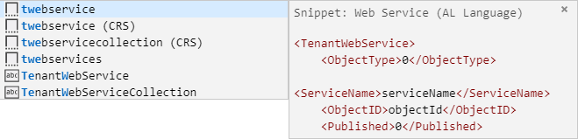
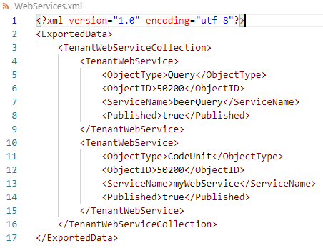
Business Central Web Services Registration
Object Types
Page
Query
Codeunit
Codeunits
Be clear, what you expose as method and parameter!!! JsonObjects are not supported
Registration XML in AL-App
XML File
Use Snippets
Add Objects for registration

Slide 21
Hands On

Slide 22
Business Central Hands-On
Prerequisites
Connect to your Workshop VM → use Instructions on your Workshop Boarding Pass
Hand On - Tasks
Create Web Services with Microsoft AL
Register Web Services in Microsoft AL

Slide 23
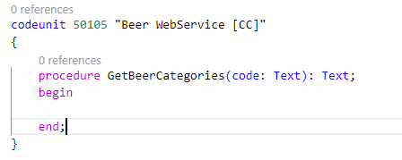
Business Central Create a Web Services from Codeunit
Create a new Codeunit
Object ID 50105
Name “Beer WebService [CC]“
Add a method “GetBeerCategories”
Parameter “code” Text
Result Text

Slide 24
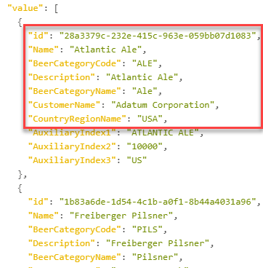
Business Central Create a Web Services from Query
Create a new Query
Object ID 50105
Name “Beer Items [CC]“
QueryType: Normal
Query from Item Table
Id, Name, Is Beer Item, Beer Category Code, Beer Category Name, Description
Join Customer Information to the query
Customer Name, Customer Region Name

Slide 25
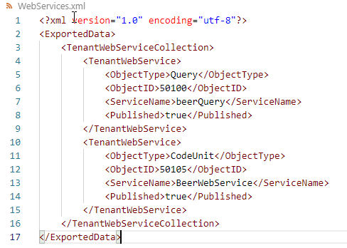
Business Central Register your Web Services
Create a XML file
“WebServices.xml”
Query as “beerQuery”
CodeUnit as “BeerWebService”
Add your Services
Use Snippets!
Deploy and Check your Web Services
Open Page “Web Services” and find your Services

Slide 26
Microsoft AL Modern APIs – Part I

Slide 27
Business Central | Modern API Available APIs (48)
Company | Finance | Sales | Purchasing | Reports
company | accounts | customers | irs1099Codes (US only) | agedAccountsPayable
companyInformation | dimensions | customerPayments | purchaseInvoices | agedAccountsReceivable
countriesRegions | dimensionLines | customerPaymentJournals | purchaseInvoiceLines | balanceSheet
currencies | dimensionValues | salesInvoices | vendors | cashFlowStatement
employees | generalLedgerEntries | salesInvoiceLines |  | incomeStatement
items | journals | salesOrders |  | retainedEarningsStatement
itemCategories | journalLines | salesOrderLines |  | customerSales
paymentMethods |  | salesQuotes |  | vendorPurchases
paymentTerms |  | salesQuoteLines |  | trialBalance
shipmentMethods |  | salesCreditMemos
taxAreas |  | salesCreditMemoLines
taxGroups
unitsOfMeasure
picture, defaultDimension, attachments, pdfDocument
Notes:
Pictures
defaultDimensions
pdfDocument
Attachments
Subscription…..
Let’s look at some of the API’s we are creating.
I’m not going to list all of there. We have created 42 API’s. A great deal of work have been put into making these API’s easy for developers to use!. And the feedback we’ve gotten from partners who we’ve held workshops and hack’a’tons with have been quite phenonomal. They really like our approach to simplicity. We ultimately want you to use as many of these API’s as possible without having to know or understand the inner workings of Financials!

Slide 28
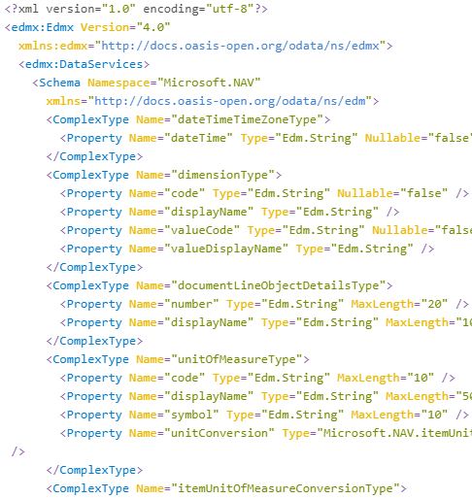
Business Central | Modern API GET endpoints (API list)
URL
<hostname>:<API port>/nav/api/<publisher>/<groupname>/<version>/
{{apiHost}}:7048/nav/api/microsoft/automation/beta/
Get endpoint – API list
add /$metadata
Operations
Get, Post, Patch, Delete
OData Filters
?$filter=<fieldname> <condition> <value> […]
?$filter=beerCategoryCode eq 'ALE' or beerCategoryCode eq 'PILS'

Slide 29
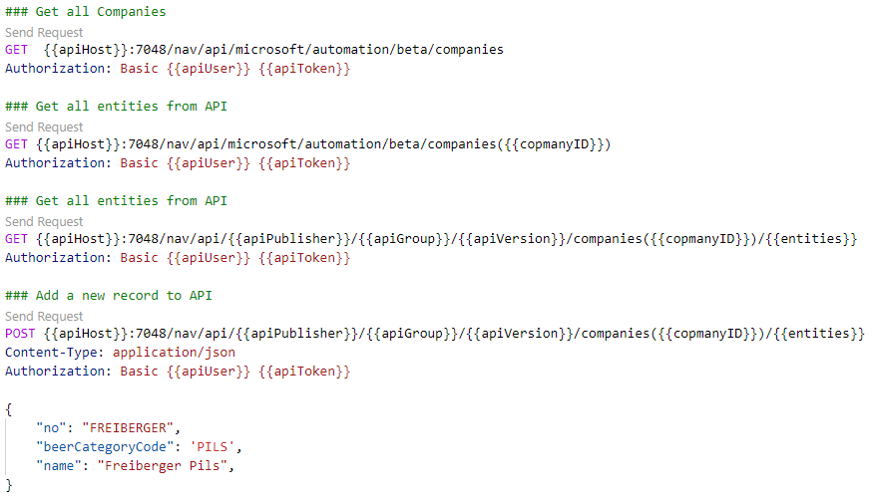
Business Central | Modern API examples

Slide 30
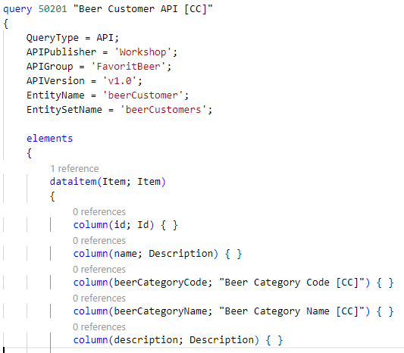
Business Central | Modern API Query
Query
OData v4
QueryType = API
Properties
APIPublisher
APIGroup
APIVersion beta, v1.0, …
EntityName
EntitySetName
Data Items, Nested Data Items, …
Names & Columns Lower Camel Case

Slide 31
Business Central | Modern API Page
Page
generate web service endpoints
cannot be displayed in the user interface
PageType = API ../Workshop/FavoritBeer/v1.0/companies({id})/beerCustomers
Properties
APIPublisher
APIGroup
APIVersion beta, v1.0, …
EntityName
EntitySetName
SourceTable
ODataKeyFields Guid
Repeater & Fields
Names Lower Camel Case

Slide 32
Business Central | Modern API Simulation & Test … REST Client
Simulation of HTTP calls
Create HTTP file (or activate the http extension) for simulation
Setup Variables for calls
@apiHost
@apiUser
@apiToken
…

Slide 33
Hands On

Slide 34
Business Central Hands-On
Prerequisites
Connect to your Workshop VM → use Instructions on your Workshop Boarding Pass
Hand On - Tasks
Simulation & Test
Create an API Query with Microsoft AL
Create an API Page in Microsoft AL

Slide 35
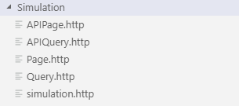
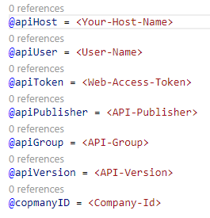
Business Central Hands-On | Simulation & Test … REST Client
Install VS Code Extension REST Client
Create a Simulation Folder
Add Simulation Files and Setup Variables for your environment
Page.http
Query.http
APIPage.http
APIQuery.http

Slide 36
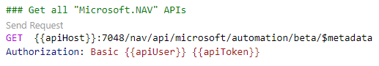
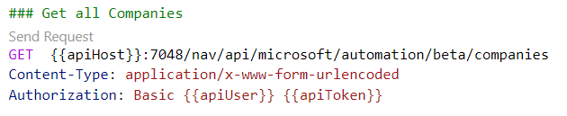
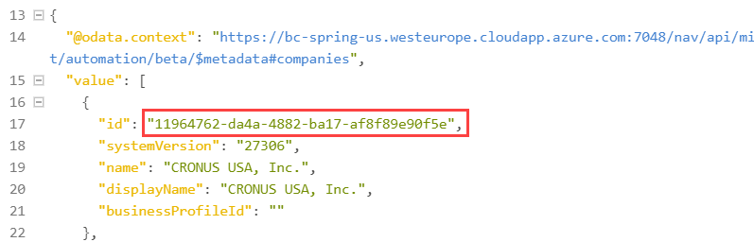
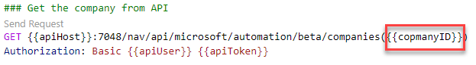
Business Central Hands-On | Simulation & Test … Explore the Services & API
Query the Metadata
/$metadata
Call „GetCompanies“
Copy the Company Name for OData Feeds & Web Services
Copy the Company ID for API calls
Setup the CompanyID variable
Get the Company
…/companies(<CompanyId>)

Slide 37
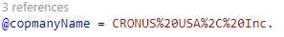
Business Central Hands-On | Simulation & Test … Explore the Services & API
Pages „VendorLedgerEntries“
Complete URL information from your Note
Get the OData feed
Get the OData v4 feed
Query „beerQuery“
Complete URL information from your Note
Get the OData feed
Get the OData v4 feed
Filter the OData v4 query by Name = 'Atlantic Ale'
Note: Company Name is needed for URL

Slide 38
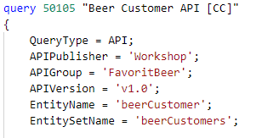
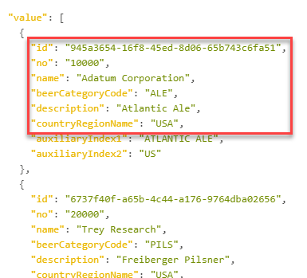
Business Central Hands-On | Create an API Query
Create a new API Query
Query ID 50105
Name “Beer Customer API [CC]“
Setup the Properties
Query from Customer Table
Id, No., Name, Beer Category Code
Join Item and Customer Information to the query
Item Description, Customer Region Name

Slide 39
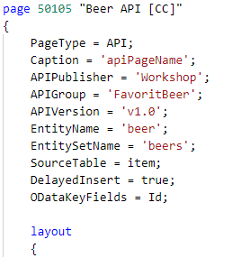
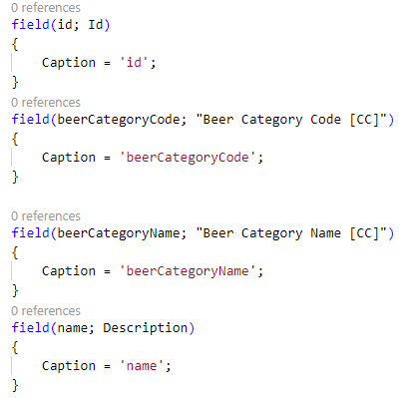
Business Central Hands-On | Create an API Page
Create a new API Page
Page ID 50105
Name “Beer API [CC]“
Add the fields to the repeater

Slide 40
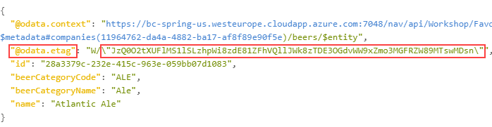
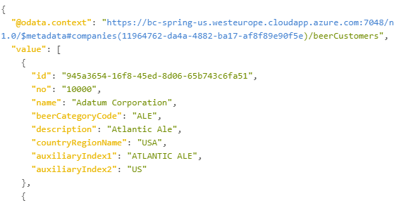
Business Central Hands-On | Test API Query and API Page
Test API Pages „Beer API [CC]“
Setup the variables in your simulation file (publisher, group, entity, entities, …)
Get all entities from „Beer API [CC]“ page {{apiVersion}}/companies({{copmanyID}})/{{entities}}
Get one entity from „Beer API [CC]“ {{apiVersion}}/companies({{copmanyID}})/{{entities}}(<id>)
Filter the entities by: Name = 'Atlantic Ale’ …/{{entities}}?$filter=…
Test API Query „ Beer Customer API [CC]“
Setup the variables in your simulation file (publisher, group, entity, entities, …)
Get all entities from „Beer API [CC]“ page {{apiVersion}}/companies({{copmanyID}})/{{entities}}
Filter the entities by: Beer Category Code = 'ALE' or 'PILS' …/{{entities}}?$filter=…

Slide 41
Microsoft AL Modern APIs Part II

Slide 42
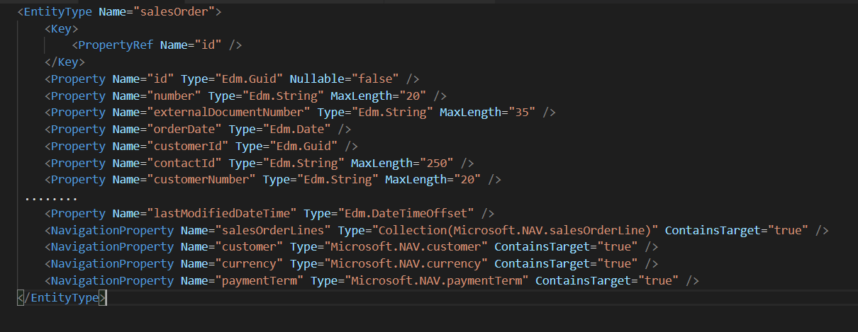
Business Central Navigation Properties
/salesOrders({{salesOrderId}})/customer

Slide 43
Business Central /api Structure
{
"@odata.etag": "W/\"JzI4O0d3QUFBQUo3QkRFQU1BQXdBREFBQUFBQUFBPT03OzEzMjM2NTUwOyc=\"",
"id": "5b0b9c1c-312d-4809-96b2-056690a11057",
"number": "1000",
"displayName": "General Landscaping",
"type": "Service",
"blocked": false,
"baseUnitOfMeasure":
{
"code": "HOUR",
"displayName": "Hour",
"symbol": null,
"unitConversion": null
},
"gtin": "",
"itemCategory": null,
"inventory": -52,
"unitPrice": 50,
"priceIncludesTax": false,
"unitCost": 27,
"taxGroupCode": "LABOR",
"lastModifiedDateTime": "2017-08-29T18:51:23.17Z"
}
@odata.etag
id (GUID)
lastModifiedDateTime
Lower camel casing
Complex Types

Slide 44
Business Central Deep Insert
Enables creating a tree of related entities in one request
{
"invoiceDate": "2016-07-26",
"dueDate": "2016-08-26",
"customerId": "653053b1-d580-4102-845f-00df29a77e1e",
"salesInvoiceLines" : [
{"itemId":"5b0b9c1c-312d-4809-96b2-056690a11057", "quantity": 4},
{"itemId":"ad7220e5-8149-4cf0-a1e6-07d2bbbf414c", "quantity": 1}
]
}

Slide 45
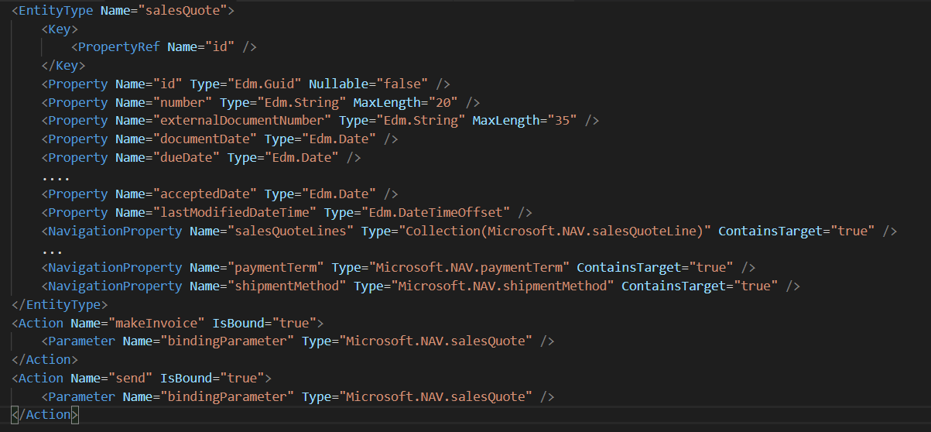
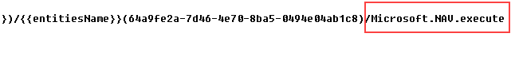
Business Central Bound Actions
Actions called through the API
Bound to an entity
Actions coming for /api endpoint
Can be created for ODataV4 web services
Method inside of API Page
Marked with Attribute “ServiceEnabled”
Data Exchange with WebServiceActionContext
HTTP Call with POST

Slide 46
Business Central Versioning for APIs
Enabled versioning of API library
https://api.businesscentral.dynamics.com/v1.0/api/beta/
https://api. businesscentral.dynamics.com/v1.0/api/v1.0/

Slide 47
Business Central Upcoming Webhook support
Operations on subscription entity
GET – list all subscriptions for a company
POST – create a new webhook subscription
DELETE – delete a subscription
PATCH – Renew a subscription

Slide 48
Business Central Get notified - subscribe
POST …./api/v1.0/subscriptions
Handshake for POST & PATCH needed.
Both parties supplies a secret, which needs to be echoed back
Client provides clientSecret
BC provides validationToken
{
"clientState":”secret",
"notificationUrl":"https://mywebsite.azurewebsites.net/api/webhook”,
"resourceUrl":”/api/v1.0/companies(name='CRONUS International Ltd.')/salesInvoices"
}

Slide 49
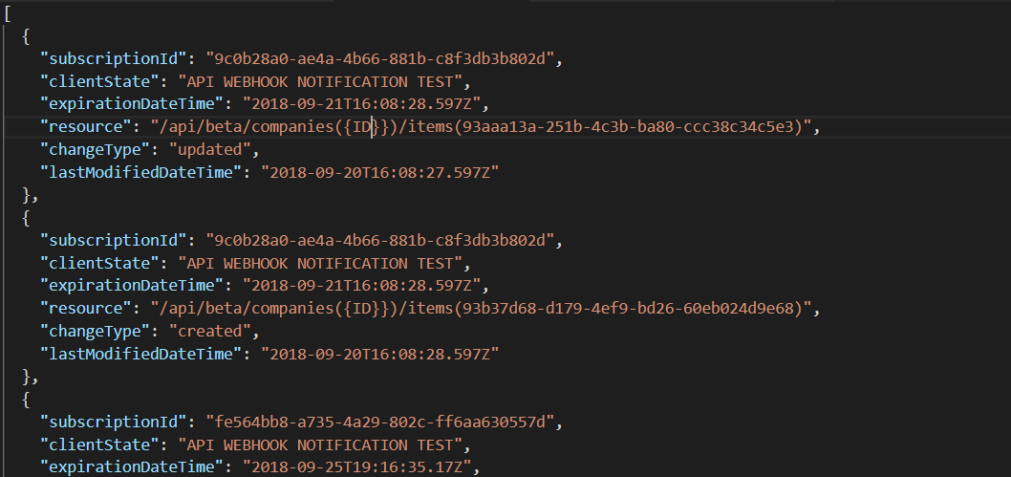
Business Central Notification payload

Slide 50
Hands On

Slide 51
Business Central Hands-On
Prerequisites
Connect to your Workshop VM → use Instructions on your Workshop Boarding Pass
Hand On - Tasks
Add, implement and test a Bound Action to the API Page
Insert some Records with API (ID Guid is necessary)

Slide 52


Microsoft AL
Competence Team DevTech
Channel Microsoft AL

